Slide 1
{Working Title}
Pablo Barbatto Mike Lubin Melissa Medina

Slide 2
Hypothesis
Movies are a worldwide, multi-billion dollar industry responsible for reaching out to hundred of millions of people each year. With so much riding on the success of each film the question is:
can Data Analysis be used to Spot trends?
Notes:
In other words: In a world where everyone is an expert and anyone can make their opinions known with the click of a button we wanted to know if a film’s IMDB score was a reliable litmus test for how well the movie would preform in the box office.

Slide 3
What Really Matters?
What Actually effects a film’s gross revenue?
IMDB Score
MPAA Rating
Film Budget
Facebook Likes
Genre
Notes:
With that question in mind we wondered what variables might be a marker of a movie’s success. While there are hundreds of variables to consider these are the ones we chose to look at.

Slide 4
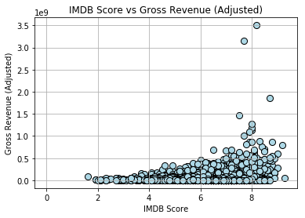
The Age of IMDB
Does a Movie’s IMDB Score, a number driven by your average, everyday moviegoer, trend with the Gross Revenue?

Slide 5
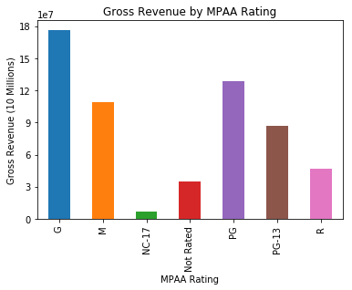
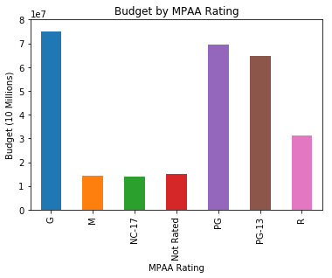
MPAA Rating
Does a movie’s MPAA Rating effect gross Revenue?
Absolutely.
Moreover it’s evident that production companies are aware of this.
Notes:
Does a movie’s MPAA rating effect Gross Revenue? Absolutely. As you can see in this graph General Admission movies make more on average than any other single rating category. And when you combine that with PG movies the results dwarf the other categories. Which is logical as you’re not limiting the number of people who can see the movie moreover kid’s movies require additional tickets for parents and kids. This is reflected in the budget when examined by MPAA rating.

Slide 6
Notes:
Here’s a side by side comparison to underscore the point, proportionally more money goes into movies studios think will make more money.

Slide 7
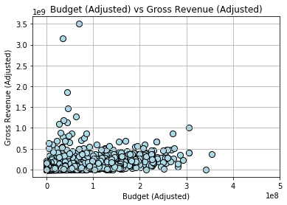
But do you Spend Money to Make Money?
Does a bigger budget translate to a bigger payday at the Box Office?
. . . Well, Not Always.

Slide 8
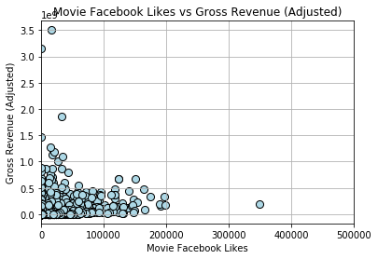
Like us on Facebook
Facebook is a billion dollar business but does the number of likes on a Movie Facebook page correlate to more Gross Revenue?
Notes:
It might be too early to tell.

Slide 9
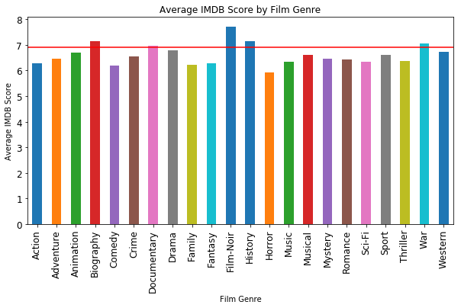
Superhero Movies are a Genre
Do Certain genres rate higher on IMDB?
Do the higher rated genres have fewer individual voters?

Slide 10
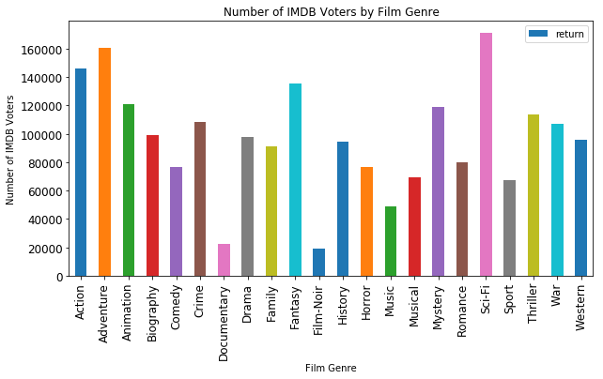
Generally the genres with the fewest Number of voters had the Higher IMDB Average.
Notes:
However there are still exceptions to that…apparently people really enjoy Biopics, Historic flicks, and War movies.
War never changes.

Slide 11
Data.World
Utilizing the hosting platform Data.World we were able to quickly locate a dataset containing information on more than five thousand films that had been previously uploaded by a user.
The dataset was stored in a CSV We then imported into Jupyter Notebook.
Source: IMDB 5000 Movie Dataset
Notes:
Using the greatest resource on the Earth we Googled “Movie Data Set” and were almost immediately directed to the Data.World website which I’m sure most of you are familiar with by now.

Slide 12
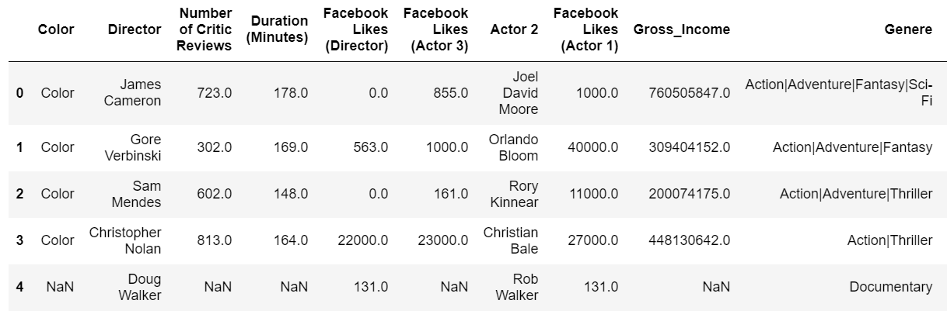
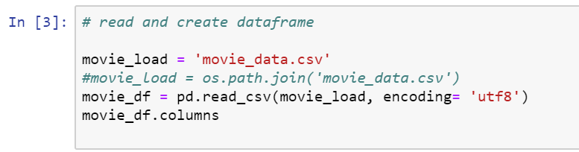
Data Cleanup
The CSV used encoding that initially made our data look very strange and hard to make out.
After we included specific Syntax to read the CSV Properly it was much easier to use.

Slide 13
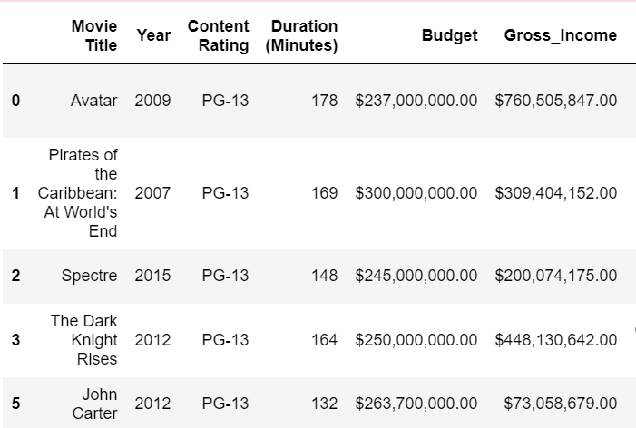
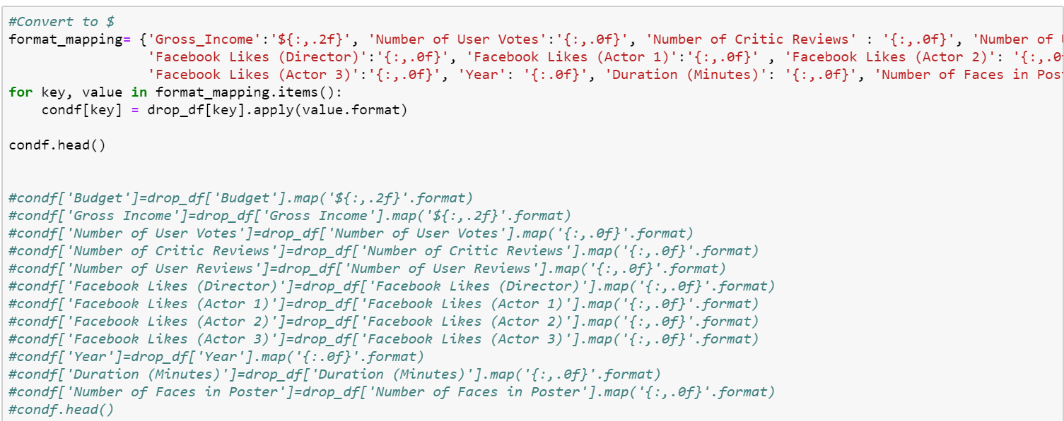
Formatting
Once we could read the data we had to format it.
We tried a couple of longer solutions but it turns out there was a short-cut.

Slide 14

More Unexpected formatting
Just when you thought it was safe to dive into the data…
Genre was a field we were very interested in but that way the data was stored made it nearly useless.
Notes:
Fortunately with use of ‘SPLIT’ we were able to break the genre data out into useful figures.

Slide 15
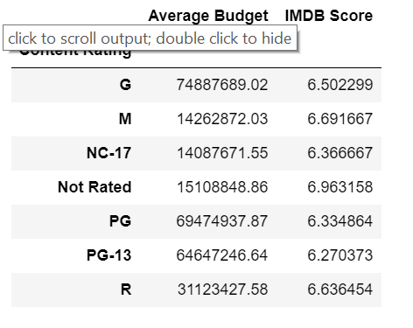
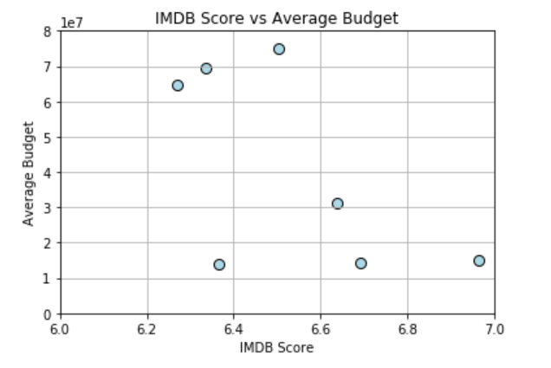
Data Analysis
With Formatted Data in hand it was time to begin the analysis process.
Storing the data into new dataframes allowed us to create graphs to visualize relationships tangibly.

Slide 16
Discussion
We found that people generally like movies. All of the genres were within the 6-8 range on an 0-10 scale.
the movie industry would hope that the more money is spent on a movie, the more the movie would gross, and our analysis does support this idea.
A surprising find is that movie ratings have a major role in revenue. G and pg movies on average have a larger budget and receive larger gross revenue.

Slide 17
Post Mortem
We had several difficulties arise while analyzing this data. To be as accurate as possible, we wanted to account for inflation. When we added inflation, we noticed that older movies would have grossed much more in today’s market than a modern blockbuster. That caused our data to become skewed and we had to set limits to drop any outliers.
Another issue was currency exchanges. We noticed some movies were costing around 20 billion to make, however this was in yen. To deal with this, we dropped movies that were not in English, USA movies.

Slide 18
If we had more time!
If we had more time we would have converted all of the countries of origin to US dollars.
We would have wanted to look at gross revenue vs awards won
Compare opening weekend to total box office and imdb score
Api keys. We would have created our own data to use from multiple sources such as critic scores vs rotten tomatoes. We really wanted to see gross revenue vs critic rating and fan ratings.

Slide 19
Q&a
Questions, comments, concerns?

